Slide 1
Rank-reduction Cadzow/MSSA
Mauricio Sacchi
University of Alberta

Slide 2
Deconvolution in F-X
Why f-x?
Linear events in t-x are predictable in f-x

Slide 3
A Model for FX data (One event)
Time Domain Delay Frequency Domain Linear Phase

Slide 4
A Model for FX data (One event)
Time Domain Delay Frequency Domain Linear Phase:
Same model as a function of Wave-number:

Slide 5
A Model for FX data (One event)
We now consider the problem as one of predicting data along the spatial coordinate for fix temporal frequency
Take for instance a linear event in t-x with the above representation in f-x, we write:

Slide 6
A Model for FX data (One envent)
From last expression, we can derive a recursive relation between the signal recorder at receiver j as a function of the signal at receiver j-1
The last simple expression is the basis for f-x prediction/deconvolution and snr enhancement
If the signal can be predicted, then the non-predictable part must be the noise
Canales, L. L., 1984, Random noise reduction: 54th Annual International Meeting, SEG, Expanded Abstracts, Session:S10.1.
Gulunay, N., 1986, FX decon and complex Wiener prediction filter: 56th Annual International Meeting, SEG, Expanded Abstracts, Session:POS2.10.
Gulunay, N., 2000, Noncausal spatial prediction filtering for random noise reduction on 3-D poststack data: Geophysics, 65, 1641-1653.

Slide 7
A Model for FX data (One event)
From last expression, we can derive a recursive relation between the signal recorder at reciever j and a function of the signal at receiver j-1
Determine a from available data the estimate noise
System of equations from where one can estimate a and the noise (Least Squares!)

Slide 8
A Model for FX data (NP events)
We can prove that if the data consists of NP linear events

Slide 9
A Model for FX data (NP events)
We can prove that if the data consists of NP linear events
The coefficients of the recursion are also called prediction error coefficients - They are related to the wavenumber of each linear event
Recursion of order NP

Slide 10
A Model for FX data (Adding noise)
LF (not NP) coefficients ??
We now consider also noise:
Suppose LF=3 and nx=24 channels
Notice that I have added noise

Slide 11
A Model for FX data (Using the available information)
Ignoring non-recorded data (Using available information only !)

Slide 12
A Model for FX data (Assuming data outside aperture=0)
Considering non-recorded data = 0

Slide 13
A Model for FX data (Assuming data outside aperture=0)
Considering non-recorded data = 0

Slide 14
A Model for FX data (NP events)
Two formulations:
Two Least Squares Solutions:

Slide 15
A Model for FX data (Algorithm)
Algorithm to recover the noise

Slide 16
A Model for FX data (Trade-off parameters)
NP does not define the filter length LF (Number of coefficients of the prediction error operator a.)
LP=LF only if the data is a superposition of NP linear events and noise=0
In general, events in the data are approximated by linear events. In addition, data are contaminated with random noise, then we choose LF > NP
Similar to the deconvolution problem, we can also add a stability factor:

Slide 17
A Model for FX data (Trade-off parameters)
LF and control the degree of noise that is modeled
Long operators will attempt to model the signal and the noise and therefore, the noise estimate will be contaminated by the signal
Short filters will only partially model the noise
FX DECON needs small overlapping windows. Why?.. Because assumes windows with constant dip data…… and a small number of dips. OK!!

Slide 18
Why the name F-X Deconvolution ?
f predicts white noise - in spiking deconvolution f also predicts white noise (the reflectivity)

Slide 19
Prediction error filter - A wave number view

Slide 20
Fxy Filters
2D Kernels - same idea but not clear to what kind of signal model one requires to justify 2D prediction error filters
1D Prediction can be performed with Forward or backward operators or a combination of both

Slide 21
Fxy Filters
y
x
Solution: could use Block Matrices and Block Solvers or operate on the flight with the Method of Conjugate Gradients

Slide 22
SSA Singular Spectrum Analysis or Cadzow Filter
SSA: an alternative to FX deconvolution ?
++
Easy to code and to understand
Easy to extend to ND
Possibility of creating noise attenuation methods that simultaneously operate in frequency and space
-+
Memory?
Note:
SSA arises from people working in dynamical systems as a method for rank reduction of 1D time series. Cadzow decomposition is a more general approach to image/signal enhancement that leads to an algorithm very similar to SSA when used to enhance complex sinusoids.

Slide 23
References
S. Trickett, 2008,F-xy Cadzow noise suppression, CSPG CSEG Convention
Broomhead, D.S., and King, G., 1986: Extracting qualitative dynamics from experimental data, Physica D, 20, 217-236.
Vautard, R., and Ghil, M., 1989: Singular spectrum analysis in nonlinear dynamics, with applications to paleoclimatic time series, Physica D, 35, 395-424.
V Oropeza and M D Sacchi, 2011, Simultaneous seismic data de-noising and reconstruction via Multichannel Singular Spectrum Analysis (MSSA), Geophysics, 76, V25-V32.

Slide 24
Theory (an easy tour of SSA) Assume we are in FX working with data in x for fixed f
Hankel Matrix of a signal of length 7 with a view of length M=4 (Trajectory Matrix)

Slide 25
Hankel Matrix of a signal of length 7 with a view of length M=4 (Trajectory Matrix)

Slide 26
Average Along anti-diagonals

Slide 27
Linear event in TX = Complex Sinusoid in FX

Slide 28
Prediction operator of length 1 is able to propagate signal from channel n-1 to channel n.

Slide 29
Single linear event in FX

Slide 30
Single linear event in FX
M is a Hankel matrix of Rank = 1

Slide 31
p linear events
It can be shown that for a superposition of p complex sinusoids (p events of different slope in FX):
M is a Hankel matrix of Rank =p

Slide 32
We will use rank reduction to attenuate random noise
The spectra of singular values can be used to determine the number of complex sinusoids (plane waves) in the window of analysis

Slide 33
SSA FX algorithm = Rank Reduction of M

Slide 34
The Cazdow/SSA filter
Hankelization Operator
Rank Reduction Operator
Anti-diagonal Averaging Operator
Cazdow/SSA Filter

Slide 35
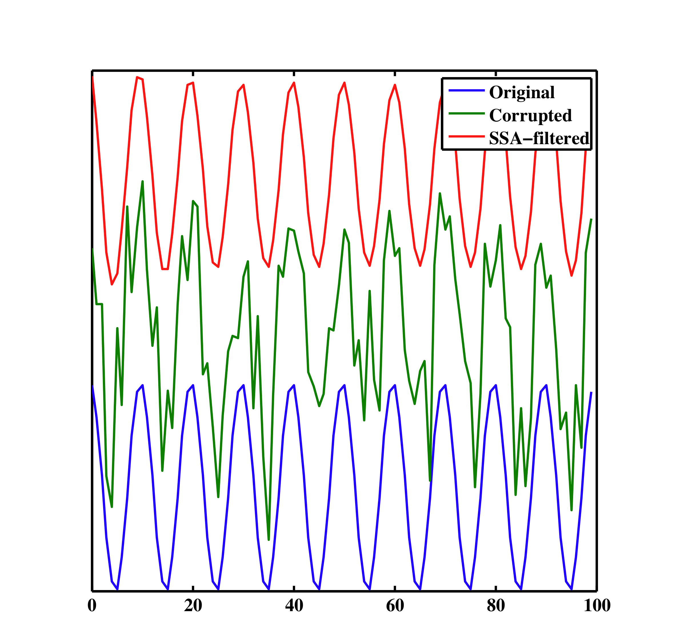
1D Example

Slide 36
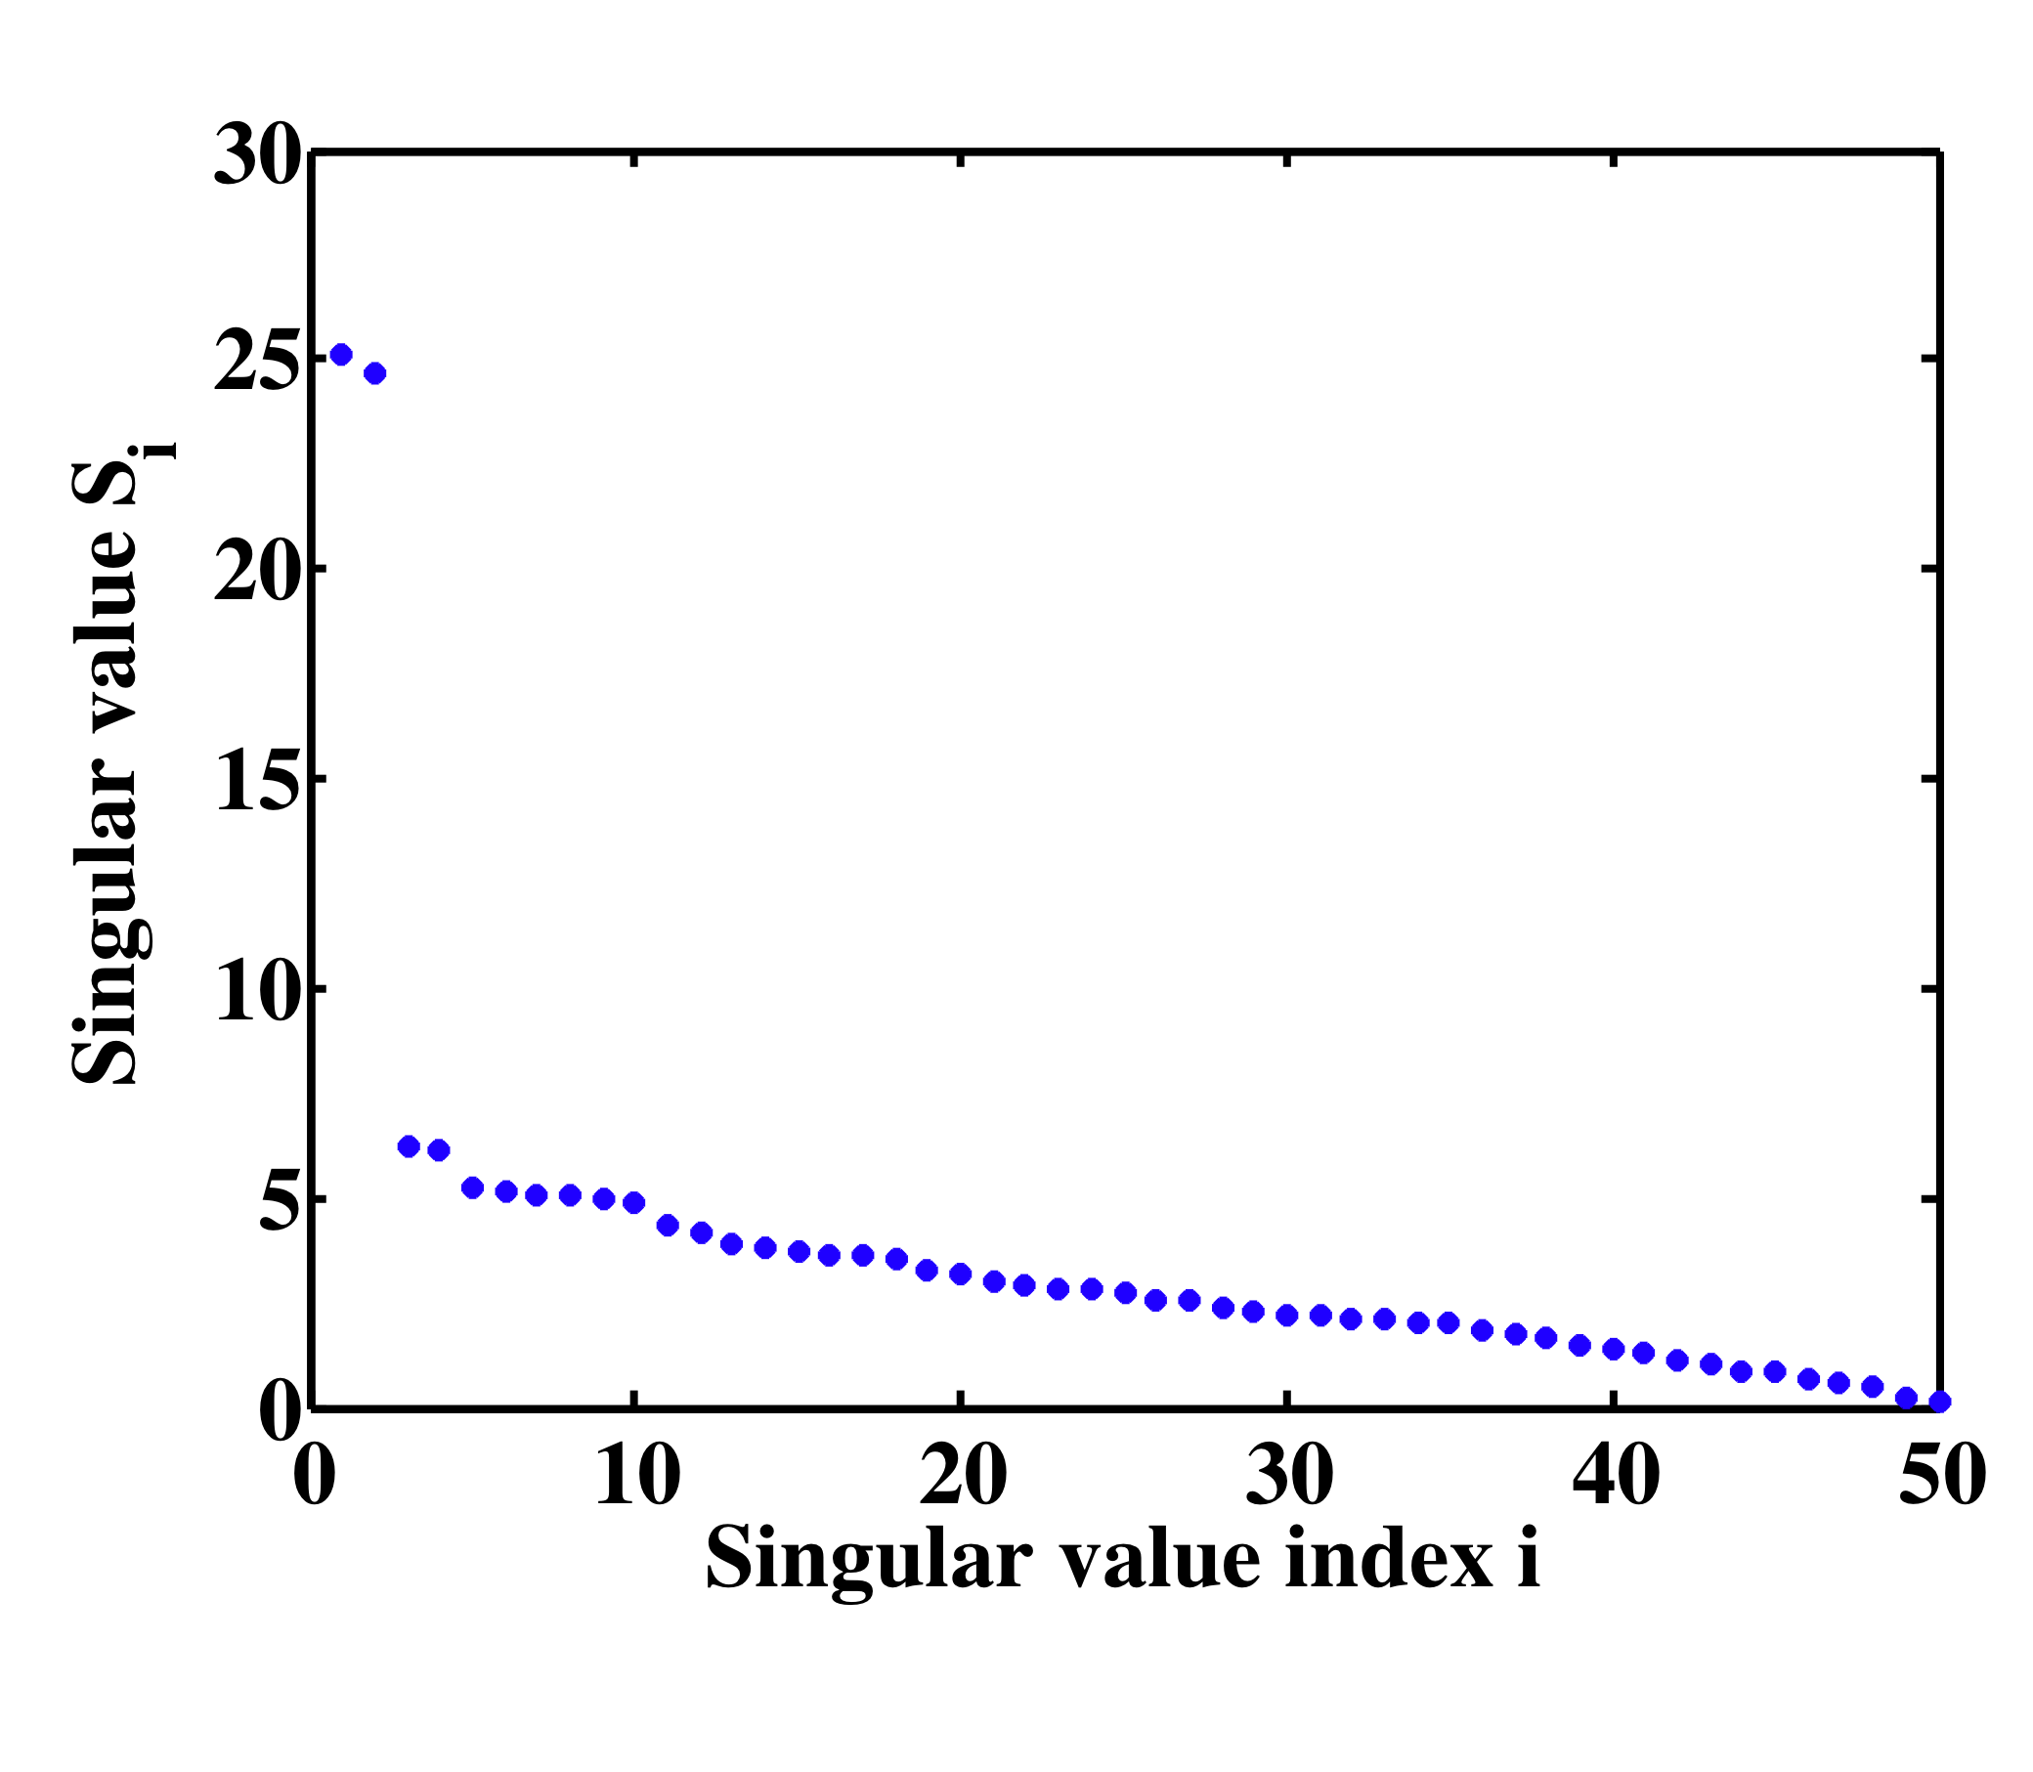
1D example
1 Real sinusoid is represented by 2 complex exponentials p=2

Slide 37
1D example
Signal
Noise

Slide 38
2D example (1D in FX)
M (view) is selected to make M (Hankel Matrix) close to a square matrix
Rest of the algorithm is very similar to FX- decon:
Decide min-max frequencies for noise attenuation
Window patching/unpatching
Adjust filter length (p in ssa) by monitoring residual panel
Use frequency domain symmetries to save time

Slide 39
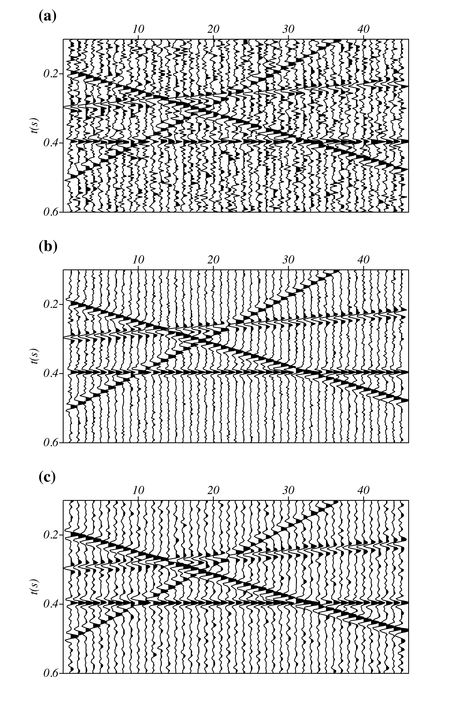
Data
FX SSA
FX Decon

Slide 40
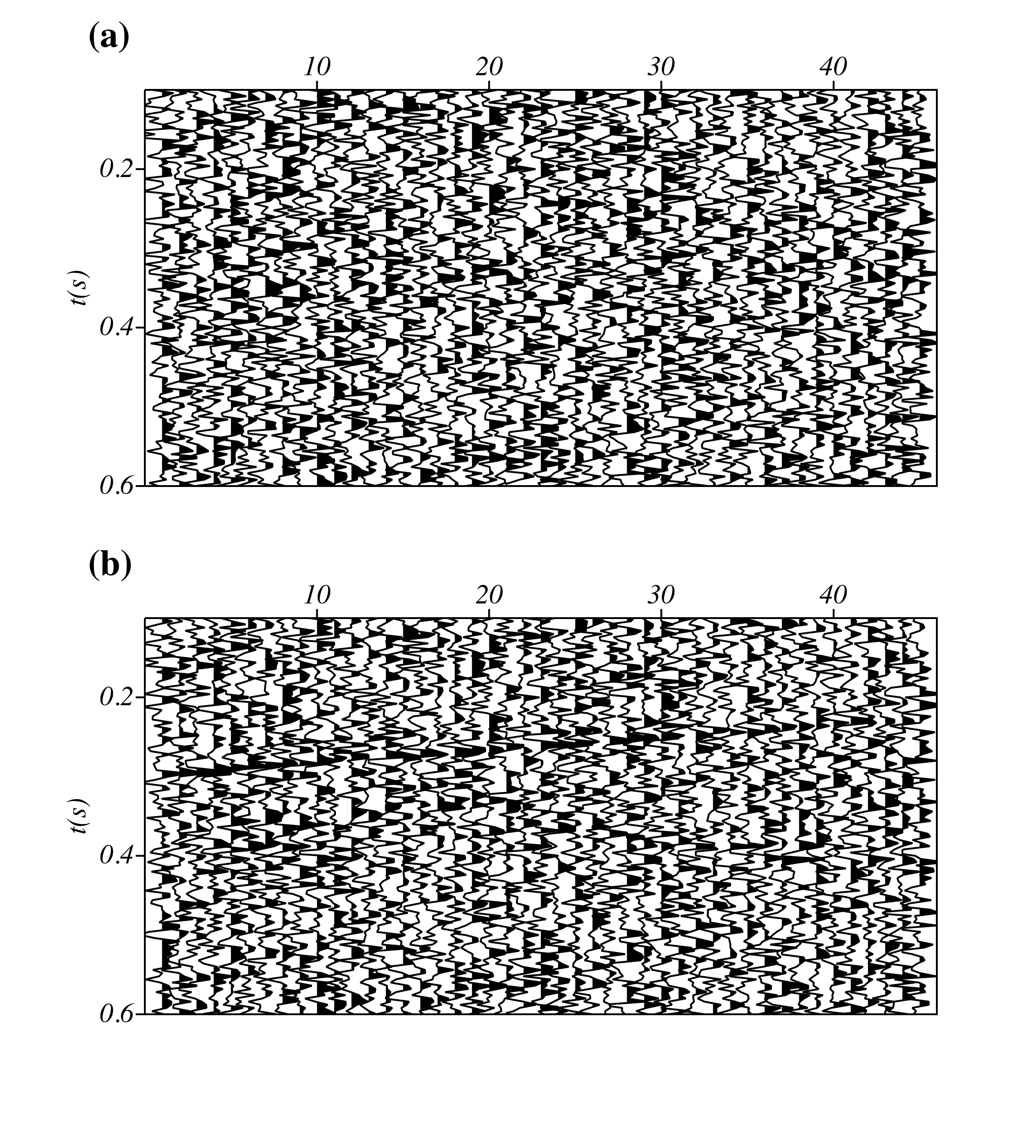
Error Panels
FX-SSA
FX-Decon

Slide 41
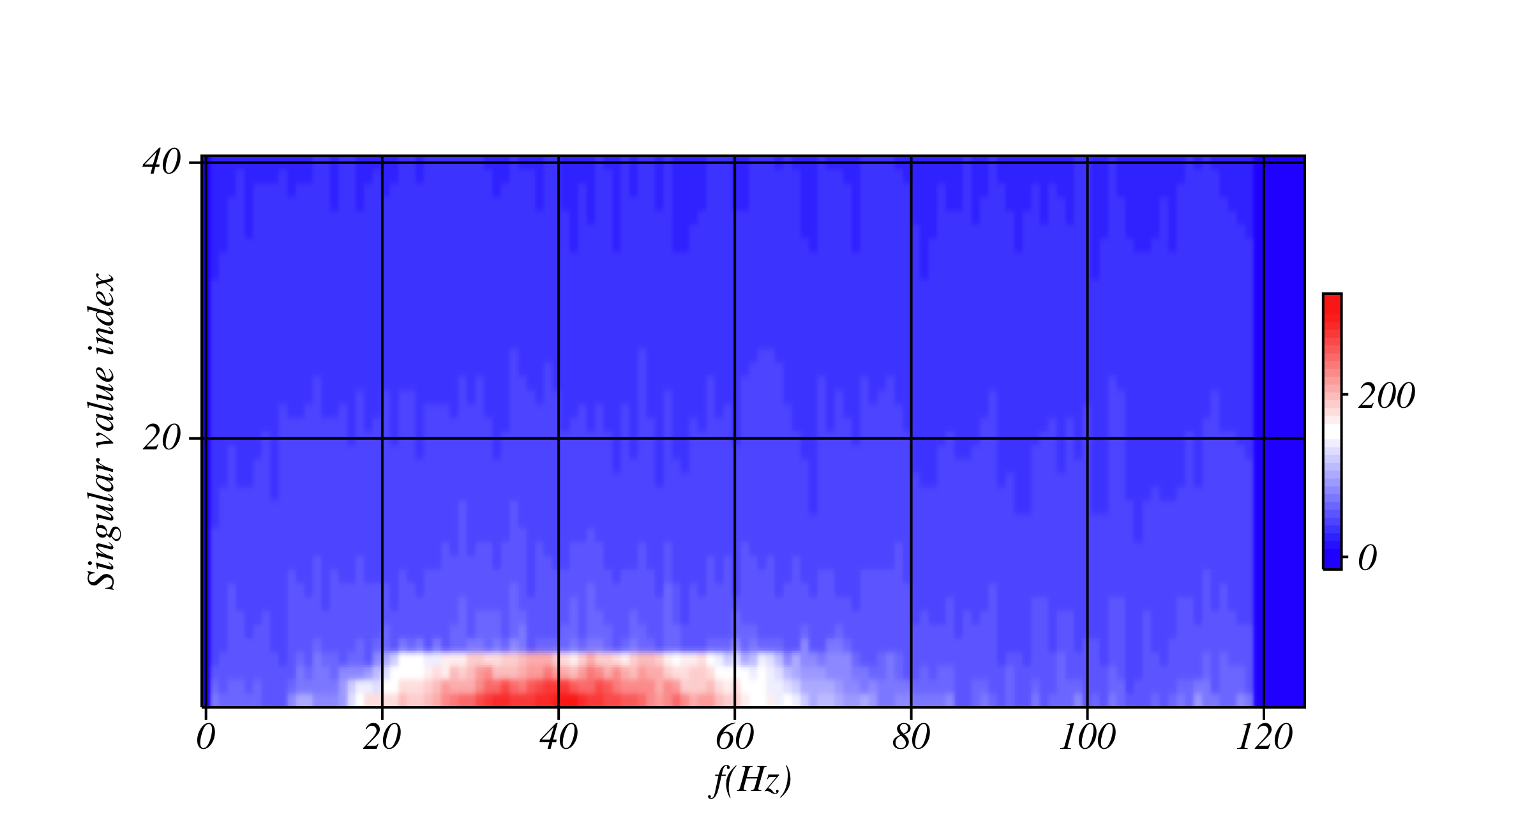
Spectrum of singular values vs. freq.
Spectra cut-off is at 4 singular values

Slide 42
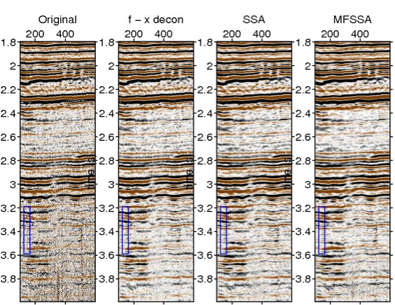
Real data comparison (Processing by V. Oropeza)

Slide 43
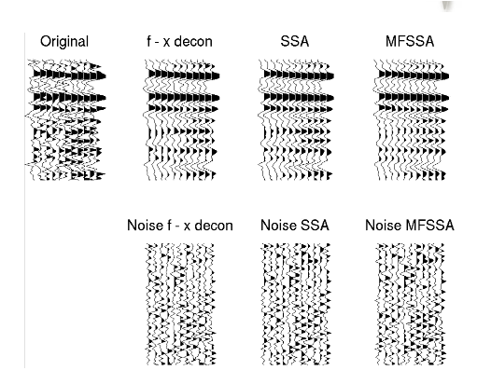
Comparison

Slide 44
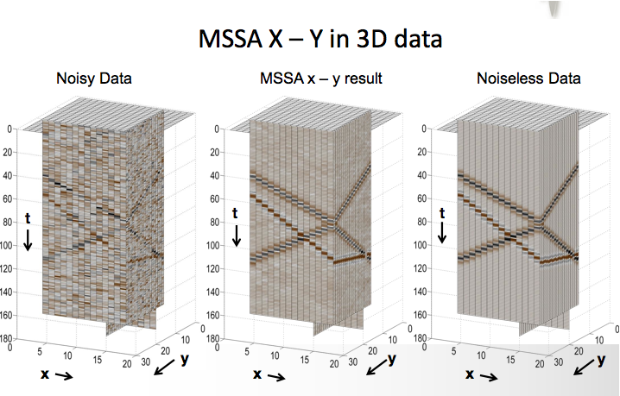
SSA for 3D cubes

Slide 45
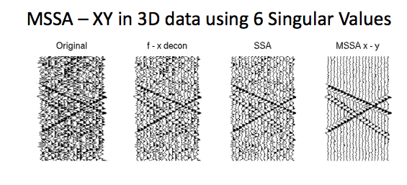
SSA works better in x-y-f than x-f (more data)

Slide 46
Notes:
RSVD (randomized SVD) can be used to speed up the SVD
For data reconstruction we used fast Lanczos solvers that exploits the structure of the Hankel matrix for fast rank reduction
These tricks are also used for data reconstruction
Gao, J., Sacchi, M., and Chen, X. (2013). ”A fast reduced-rank interpolation method for prestack seismic volumes that depend on four spatial dimensions.” GEOPHYSICS, 78(1), V21–V30.

